Slide 1
Work Progress
By: Abdur Rehman

Slide 2
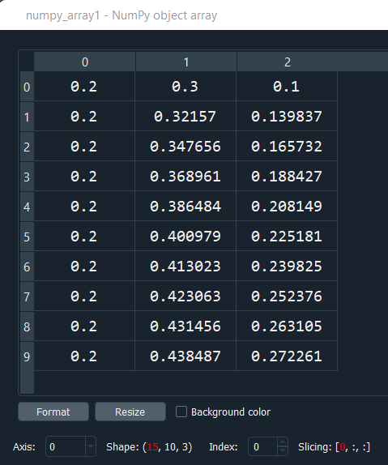
Model Training and Evaluation
Input used CAin as numpy_array:
array([1., 1., 1., 1., 1., 0., 0., 0., 0., 0., 1., 1., 1., 1., 1.])
numpy_array.shape:
Out[6]: (15,)
Output used as numpy_array1 for three states:
numpy_array1.shape:
Out[8]: (15, 10, 3)

Slide 3
For the training and testing of data, the data is split into 80% for the training and 20% testing:
X_train, X_test, y_train, y_test = train_test_split(numpy_array, numpy_array1, test_size=0.2,)
Reshaped the data to fit the model using reshape
X_train= np.reshape(X_train, X_train.shape + (1,))
X_test= np.reshape(X_test, X_test.shape + (1,))
y_train= y_train.reshape(12,30)
y_test= y_test.reshape(3,30)
Configure the network with optimizer, loss function and accuracy
network.compile(optimizer=keras.optimizers.RMSprop(lr=0.01), loss='mse’, metics=['mae’])
history = network.fit(X_train, y_train,validation_data=(X_test, y_test),epochs=100, batch_size=20)
history_dict = history.history
loss_values = history_dict['loss']
val_loss_values = history_dict['val_loss']
plt.figure()
plt.plot(loss_values, 'bo', label='training loss')
plt.plot(val_loss_values, 'r', label='val training loss')
network.evaluate(X_train,y_train)
network.evaluate(X_test,y_test)

Slide 4
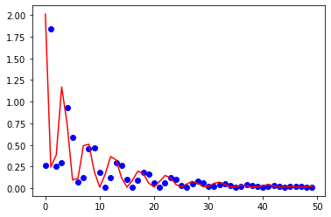
Value Training Loss:

Slide 5
network.evaluate(X_train,y_train):
0.02056201361119747
network.evaluate(X_test,y_test):
0.0008072762284427881
The R2 score on the Train set is:
-2.165
The R2 score on the Test set is:
-56184616704692019966491842576384.000

Slide 6
Second Stage:
Earlier, the training and testing of data, the data is split into 80% for the training and 20% testing randomly.
For the next stage, we designated the data by assigning certain data set for the training and the remainder for the testing without the randomness.
X_train = df.iloc[:130]
X_test = df.iloc[130:]
y_train = df1.iloc[:130]
y_test = df1.iloc[130:]
Further, we configure the network with optimizer, loss function and accuracy parameters:
model = Sequential()
model.add(Dense(1, input_shape=(1,)))
model.add(Dense(8, activation='relu'))
model.add(Dense(3, activation='sigmoid’))
model.compile(loss='binary_crossentropy', optimizer='adam', metrics=['accuracy'])

Slide 7
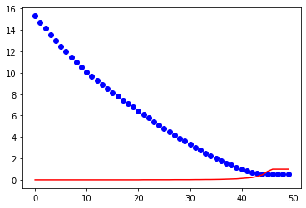
Value Training Loss:

Slide 8
network.evaluate(X_train,y_train):
0.0231
network.evaluate(X_test,y_test):
0.07183591276407242
The R2 score on the Train set is:
-1.114
The R2 score on the Test set is:
-22340887724973198076146614272

Slide 9
Hyperparameter Tuning
The first thing we need to do is writing a function, which returns a compiled Keras model.
It takes an argument hp for defining the hyperparameters while building the model.
def build_model(hp):
model = tf.keras.models.Sequential()
# check the shape again of the input
model.add(layers.Flatten(input_shape=(1,)))
# changing the hidden layers and with different activation functions
for i in range(hp.Int('layers', 2, 6)):
model.add(tf.keras.layers.Dense( units=hp.Int('units_' + str(i), 50, 100, step=10), activation=hp.Choice('act_)' + str(i), ['relu', 'sigmoid'])))
model.add(layers.Dense(1, activation='softmax’))
model.compile(optimizer=keras.optimizers.Adam(hp.Choice('learning_rate’, values=[1e-2, 1e-4])), loss='sparse_categorical_crossentropy', metrics=['accuracy’])
return model

Slide 10
We need to select a tuner class to run the search.
tuner = RandomSearch(
build_model,
objective='val_accuracy',
max_trials=5,
executions_per_trial=3,
directory='my_dir',
project_name='helloworld’)
tuner.search_space_summary()

Slide 11
You can print a summary of the search space:
Hyperparameters:
units: 160
learning_rate: 0.0001
Score: 0.8569333354632059
Hyperparameters:
units: 416
learning_rate: 0.01
Score: 0.8469666639963785
Hyperparameters:
units: 288
learning_rate: 0.01
Score: 0.8468666672706604

